Slide 1
Mastering Clinical Trial Reporting
Matt Becker, Life Science Strategic Advisor, SAS

Slide 2
Clinical Trials
What are They
“Clinical trials are research studies that explore whether a medical strategy, treatment, or device is safe and effective for humans. These studies also may show which medical approaches work best for certain illnesses or groups of people. Clinical trials produce the best data available for health care decision making.”
NIH: https://www.nhlbi.nih.gov/studies/clinicaltrials

Slide 3
Clinical Research
Types of Trials
Phase I
Phase II
Phase III
What dose is safe?
Does it work?
How does it Compare?
Phase IV
How’s it doing in the ‘real world’
20 – 200
10 – 20 subjects
>1,000
IIA – dosing
IIB - efficacy
IA – SAD
IB - MAD
May be Required
Competitive
Safety & Efficacy
Notes:
SAD – Single ascending dose – 3 people given a single does, if they are of, then next 3 get a higher dose. If bad, next 3 get same dose
MAD – multiple ascending dose – start a group with a regimen with multiple doses, move up if safe

Slide 4
Clinical Research
Define the question
Sample Size & Population
Protocol
Analysis Plan
Execute
Move on
Unblind
Trial Setup & Execution
Notes:
FDA input happens early in the process (in phase III, usually)

Slide 5
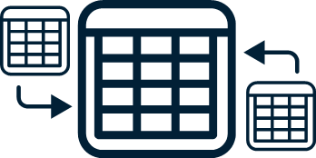
Execution
Data Standards
Standard Data Tabulation Model (SDTM)
Raw structure to standard metadata structure
Analysis Dataset Model (ADaM)
Analysis ready metadata structure for tables, listings*, figures (TLFs)

Slide 6
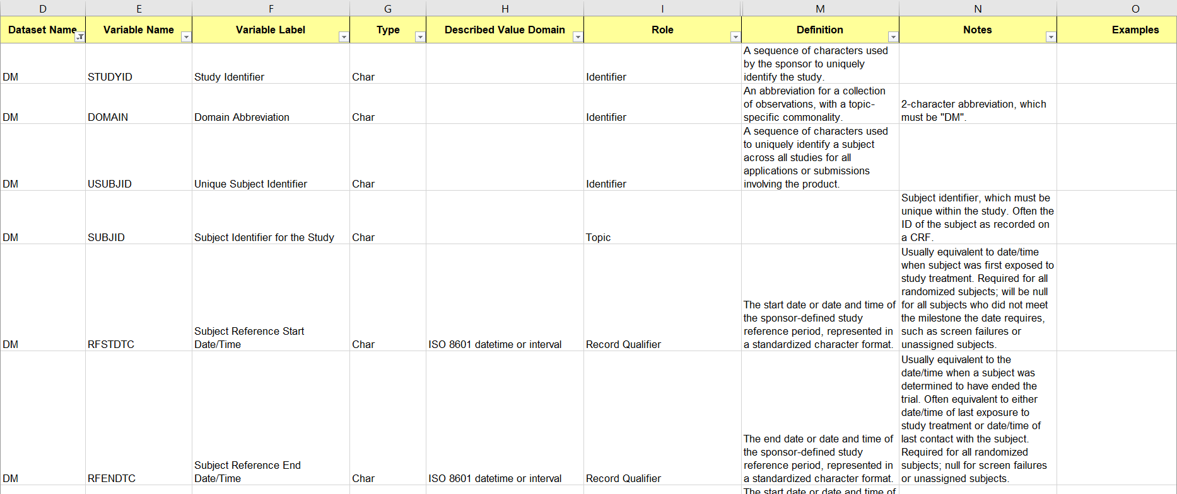
Execution
SDTM – Demographics (DM)

Slide 7
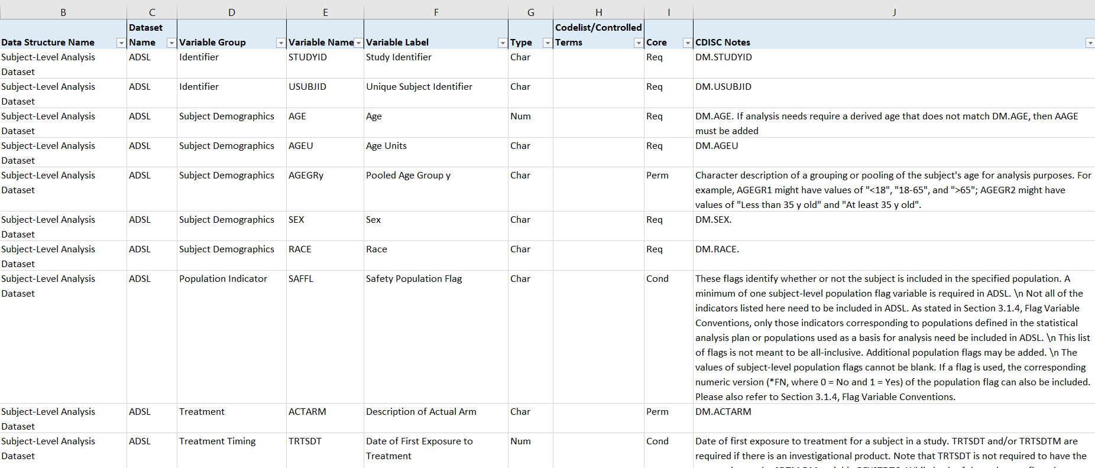
Execution
ADaM – Subject Level Analysis Dataset (ADSL)

Slide 8
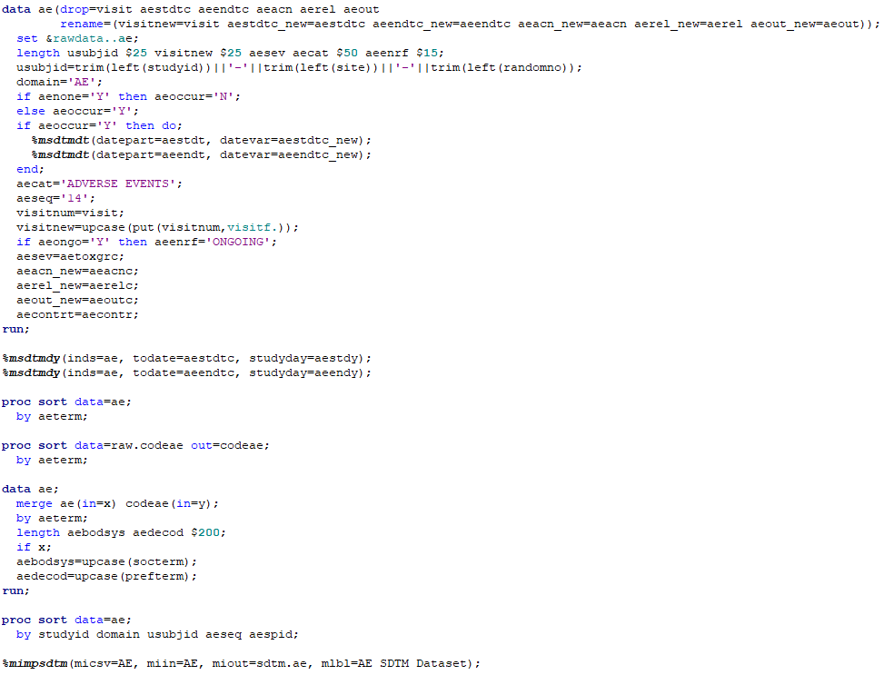
Execution
Data Mapping - Common Code
Data step / Proc SQL
Variable creation
Variable assignment
Merging data
Saving data
Macros for common algorithms
Study day calculations
Date variable creation
Others as desired
Common Procs
Proc SQL, Sort, Transpose, Freq, Means, Summary

Slide 9
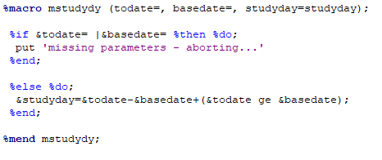
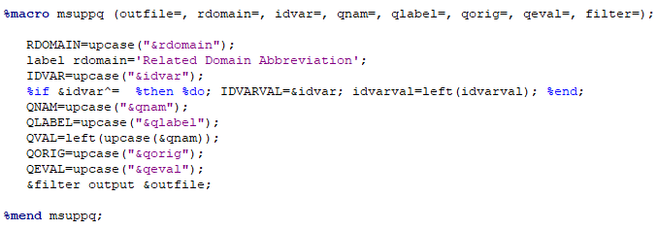
Execution
Data Mapping - Common Code

Slide 10
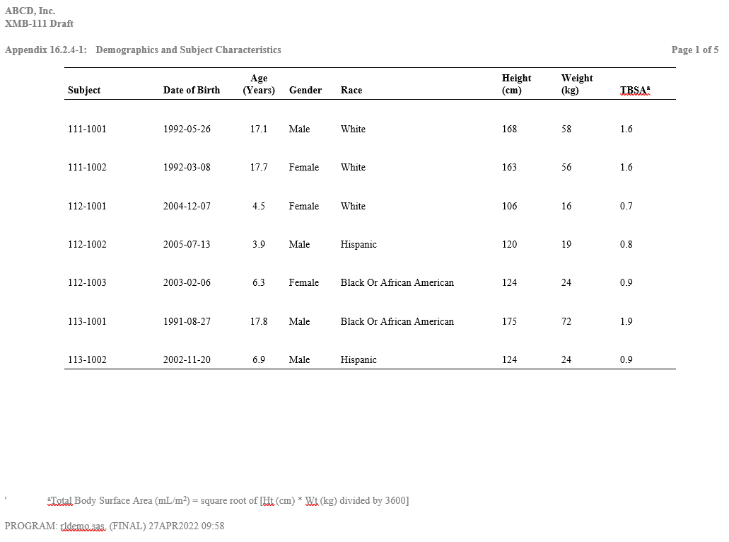
Execution
Baseline - Listing

Slide 11
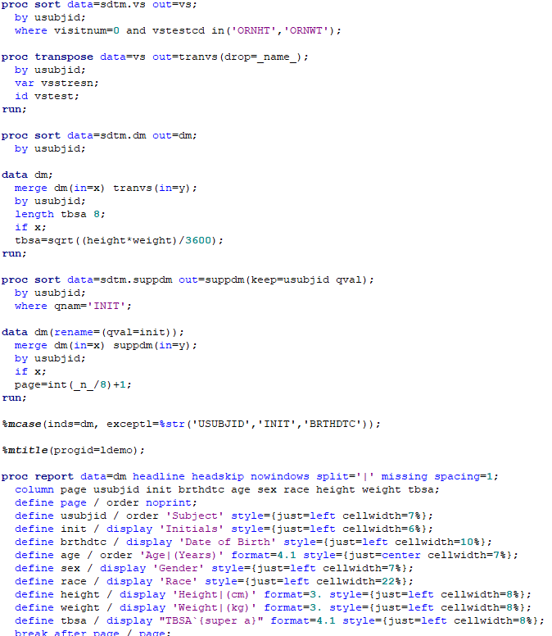
Execution
Listings - Common Code
Data step / Proc SQL
Variable creation
Variable assignment
Merging data
Macros for common algorithms
As needed(e.g. case)
Common Procs
SQL, Sort, Transpose, Report
ODS statements

Slide 12
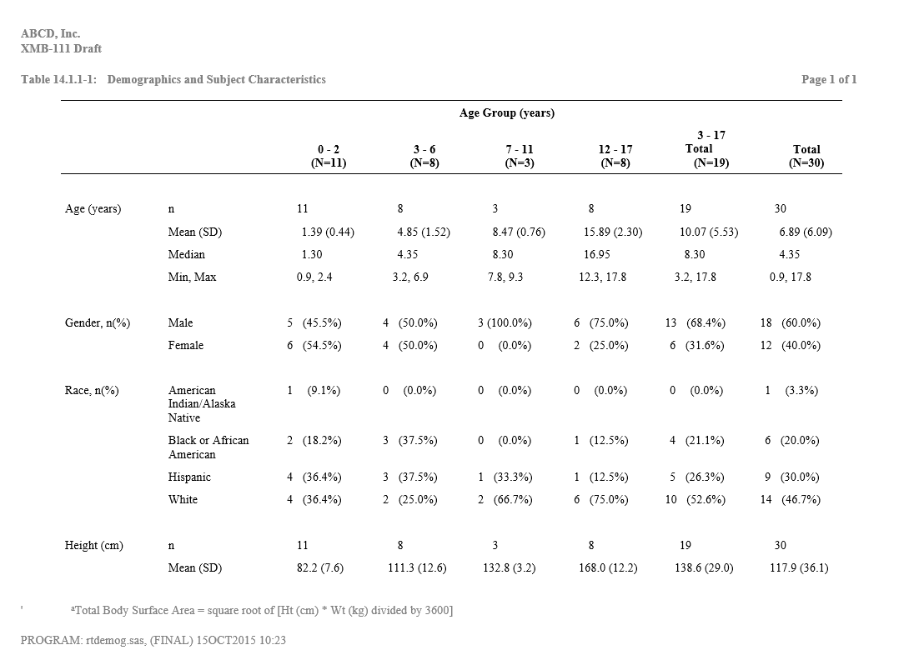
Execution
Baseline - Table

Slide 13
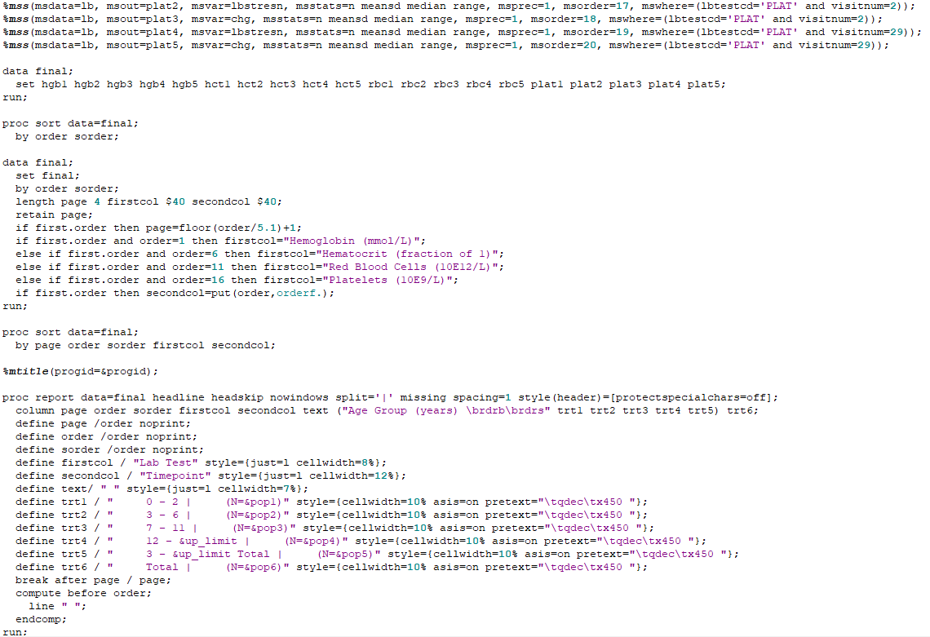
Execution
Tables - Common Code
Data step / Proc SQL
Variable creation
Variable assignment
Merging data
Macros for common algorithms
Categorical analysis
Discrete analysis
P-values
Others as desired
Common Procs
SQL, Sort, Transpose, Report, Means, Freq, Summary, Ttest, Lifetest
ODS Statements

Slide 14
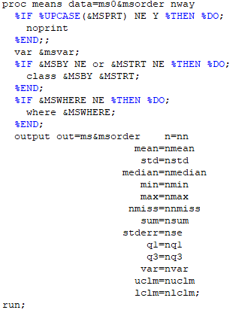
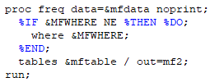
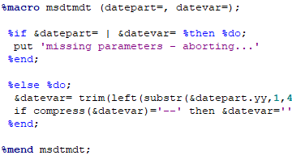
Execution
Common Code Examples

Slide 15
Challenges
Concerns for Clinical Trials
System must be validated – 21 CFR Part 11
Tight access controls required – Blinded & Unblinded Data
Data standards adherence
Managing multiple workflows and multiple users
Following SOPs – Traceability & Auditability
FDA Submission – Risk Adverse

